Slide 1
Troubleshooting vCenter Server and ESXi
Module 7

Slide 2
Importance
Your ability to manage VMware vCenter ServerTM and VMware ESXiTM hosts can be reduced or eliminated if some of the key components are misconfigured. You must correct configuration problems quickly to reestablish management control.

Slide 3
You Are Here
Course Introduction
Introduction to Troubleshooting
Troubleshooting Tools
Troubleshooting Virtual Networking
Troubleshooting Storage
Troubleshooting vSphere Clusters
Troubleshooting vCenter Server and ESXi
Troubleshooting Virtual Machines

Slide 4
Learner Objectives
By the end of this module, you should be able to meet the following objectives:
Understand VMware vSphere® 6 architecture and main components
Troubleshoot authentication and certificate problems
Analyze and solve vCenter Server service problems
Diagnose and troubleshoot vCenter Server database problems
Use the VMware vCenterTM Server ApplianceTM shell and the Bash shell to identify and solve problems
Identify and troubleshoot ESXi host problems

Slide 5
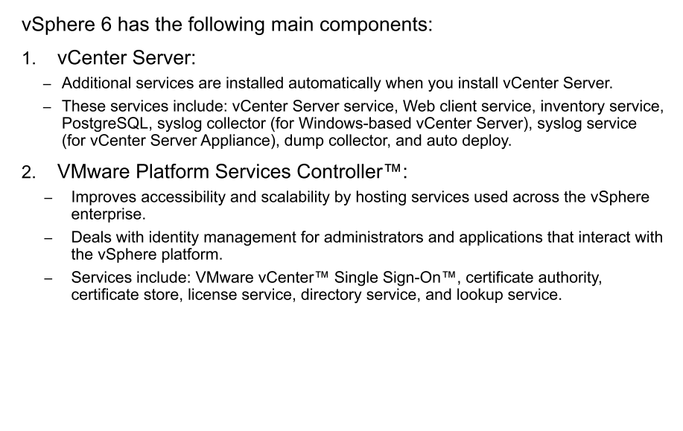
vSphere 6 Architecture

Slide 6
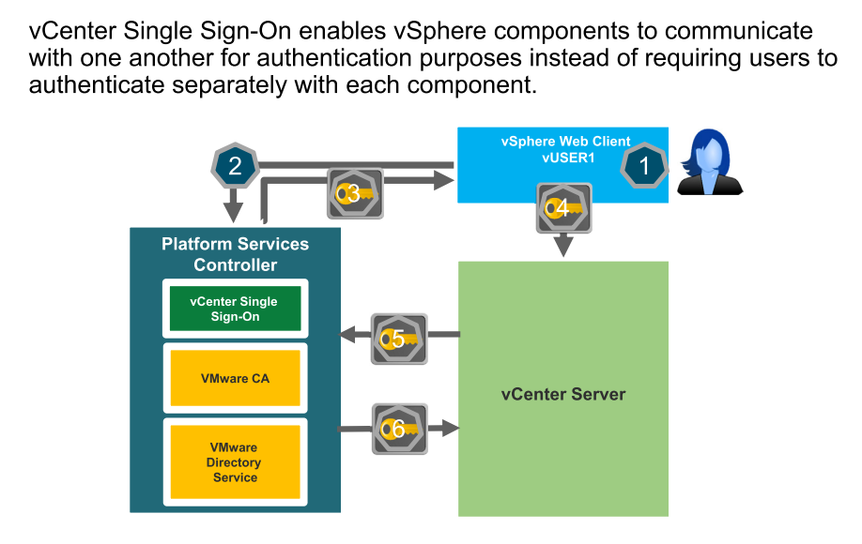
Review of vCenter Single Sign-On
Notes:
vSphere Web Client passes the login information to the vCenter Single Sign-On service, which checks the SAML token of the vSphere Web Client. If the vSphere Web Client has a valid token, vCenter Single Sign-On checks whether the user is in a configured identity source, for example Active Directory (AD).
If no domain name is entered with the user name, vCenter Single Sign-On checks in the default vCenter Single Sign-On domain, vsphere.local.

Slide 7
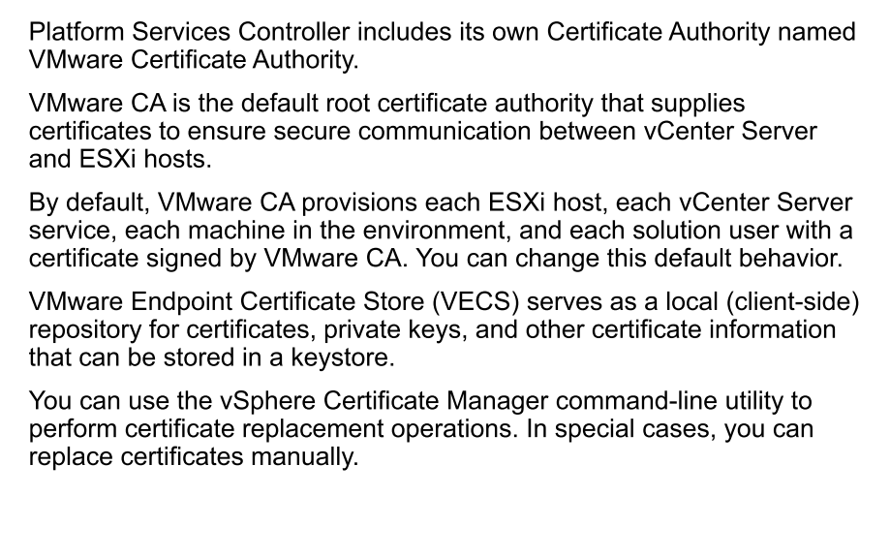
VMware CA and Certificate Store

Slide 8
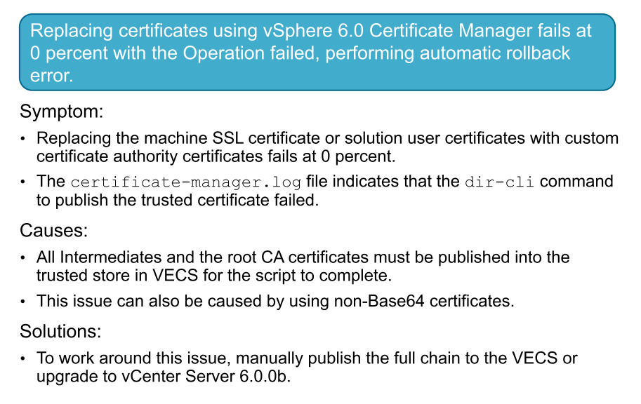
Certificate Problem

Slide 9
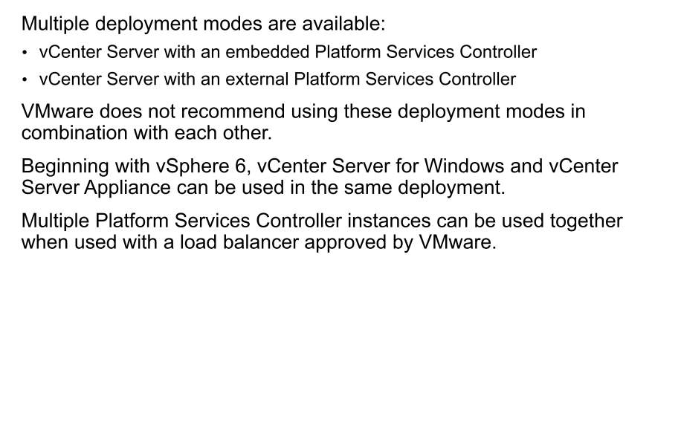
vSphere 6 Deployment Modes Review

Slide 10
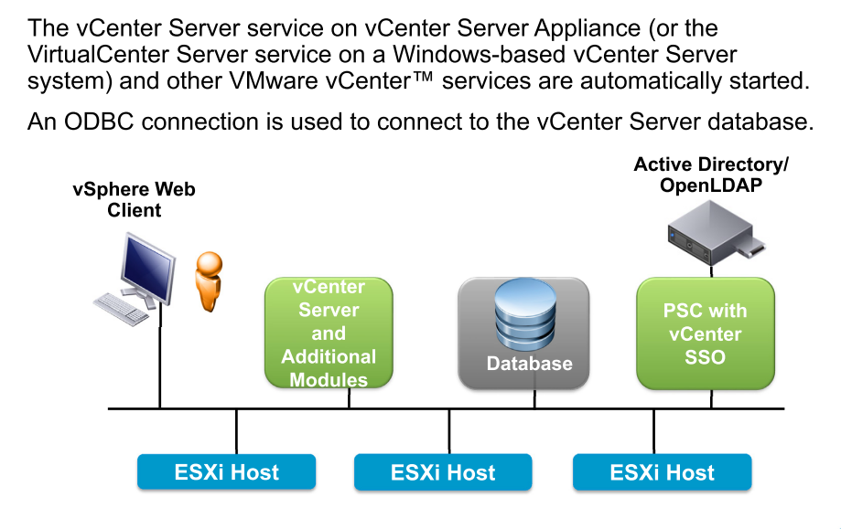
Review of vCenter Server Components

Slide 11
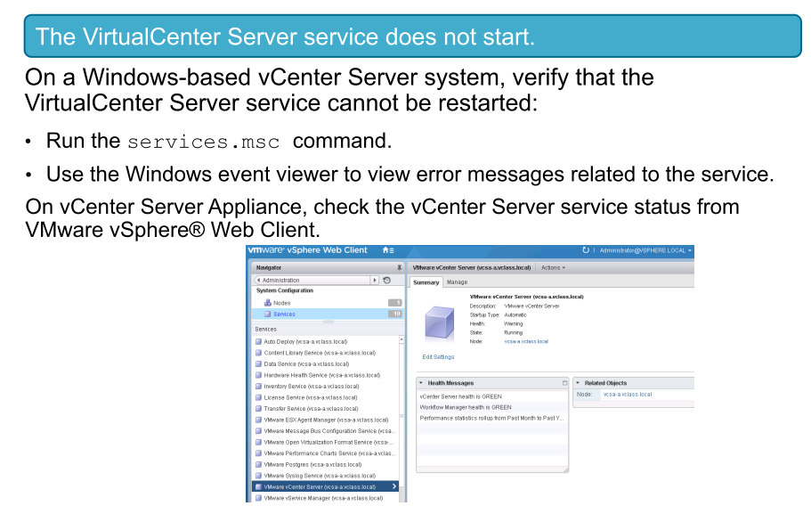
vCenter Server Problem 1

Slide 12
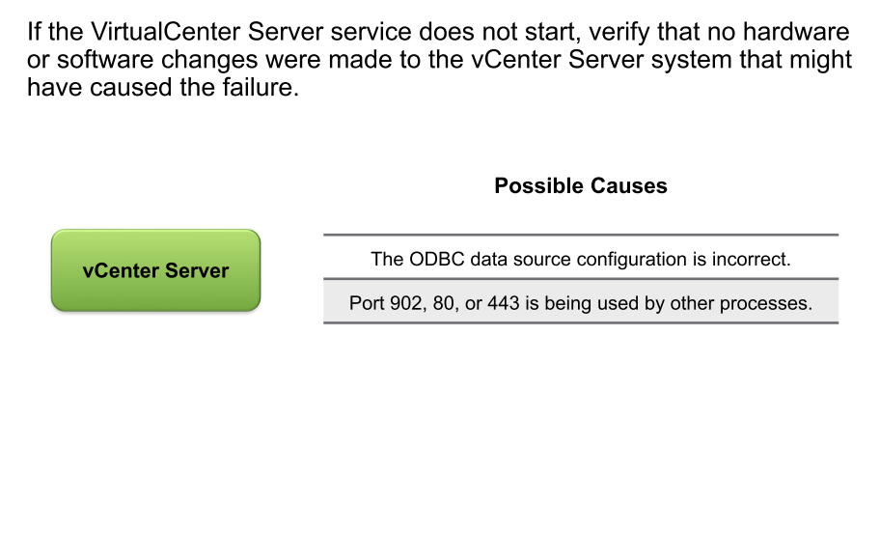
Identifying Possible Causes

Slide 13
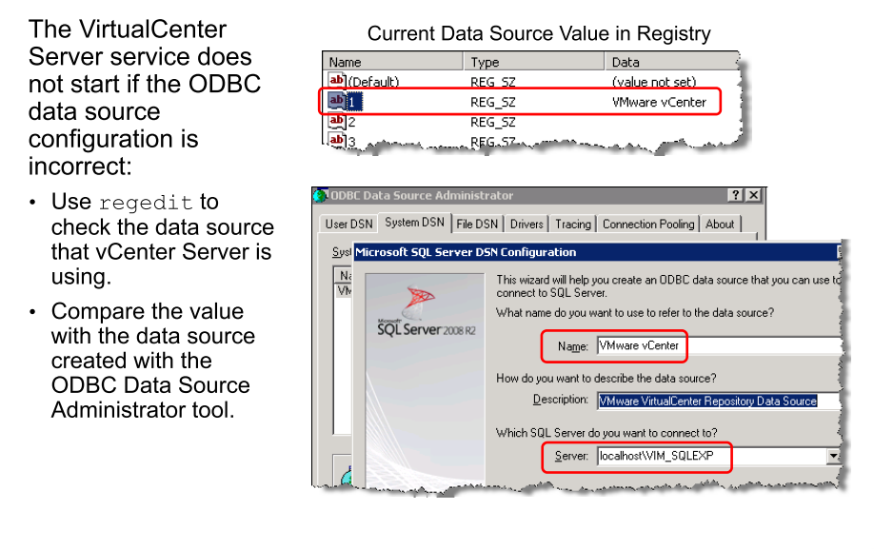
Possible Cause: ODBC Misconfiguration
Notes:
HKEY_LOCAL_MACHINE\SOFTWARE\VMware, Inc.\VMware VirtualCenter\DB

Slide 14
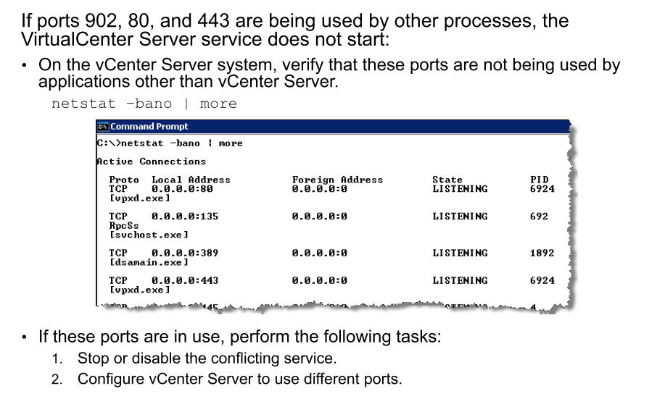
Possible Cause: Ports 902, 80, and 443 in Use

Slide 15
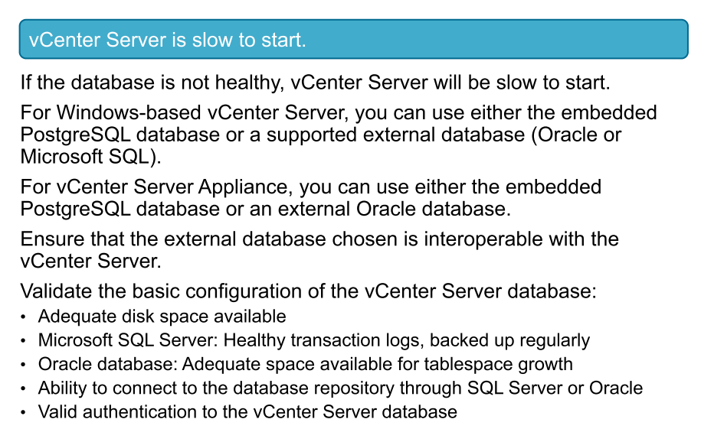
vCenter Server Problem 2

Slide 16
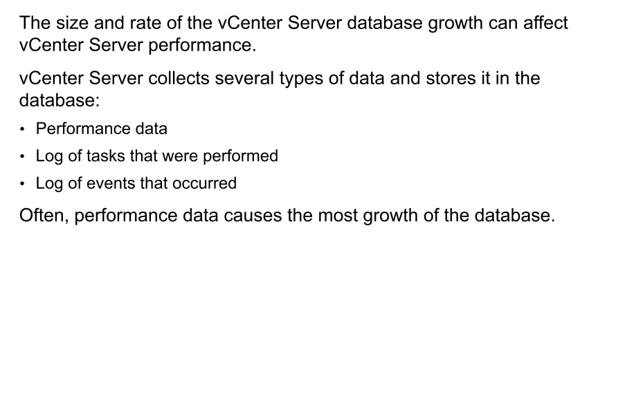
Growth of the vCenter Server Database

Slide 17
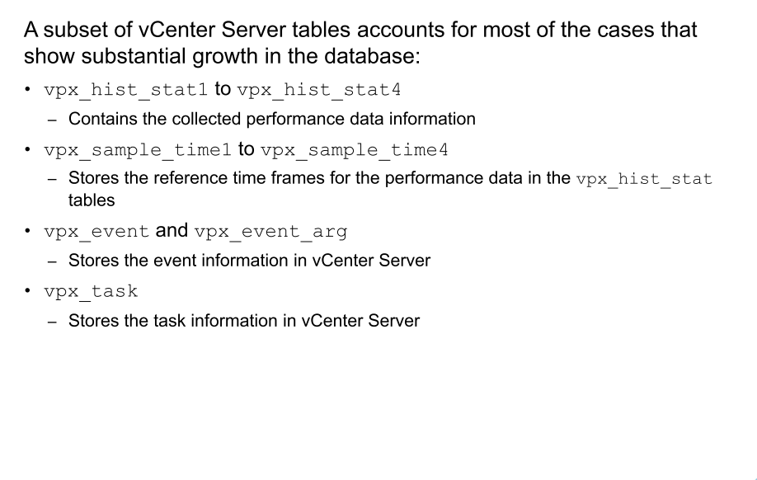
vCenter Server Database Tables That Typically Grow

Slide 18
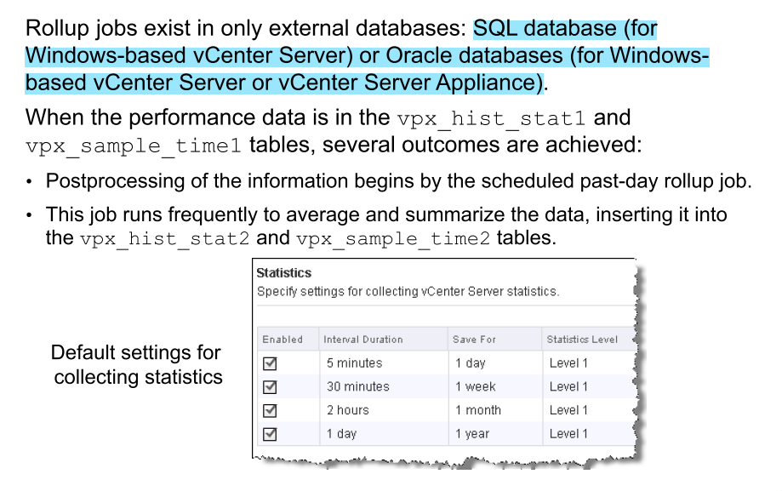
Rollup Jobs Control Growth

Slide 19
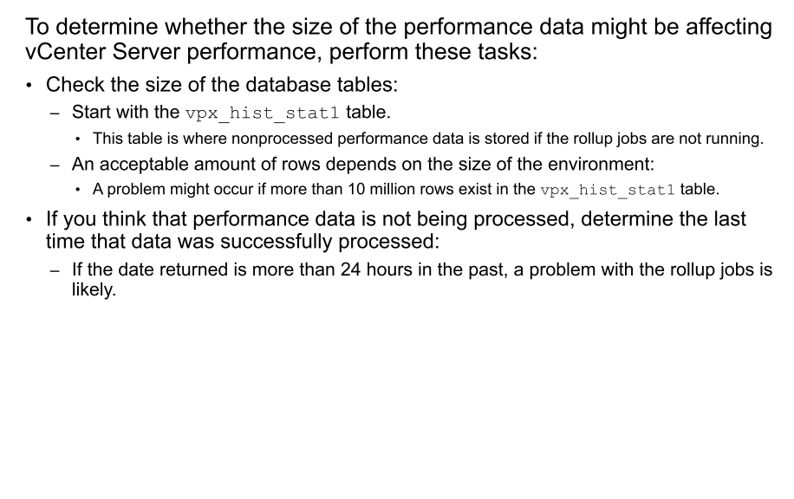
Verifying the Size of the Database Tables

Slide 20
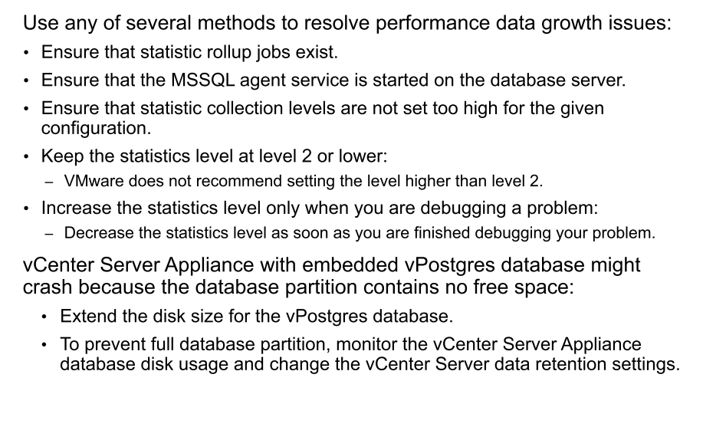
Resolving Performance Data Growth Issues

Slide 21
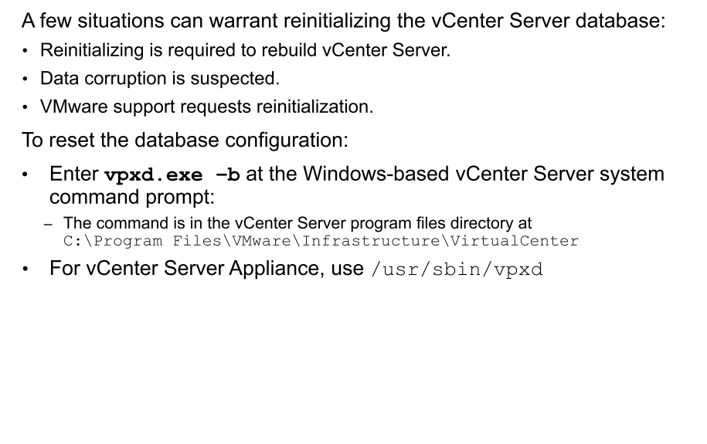
Reinitializing the vCenter Server Database

Slide 22
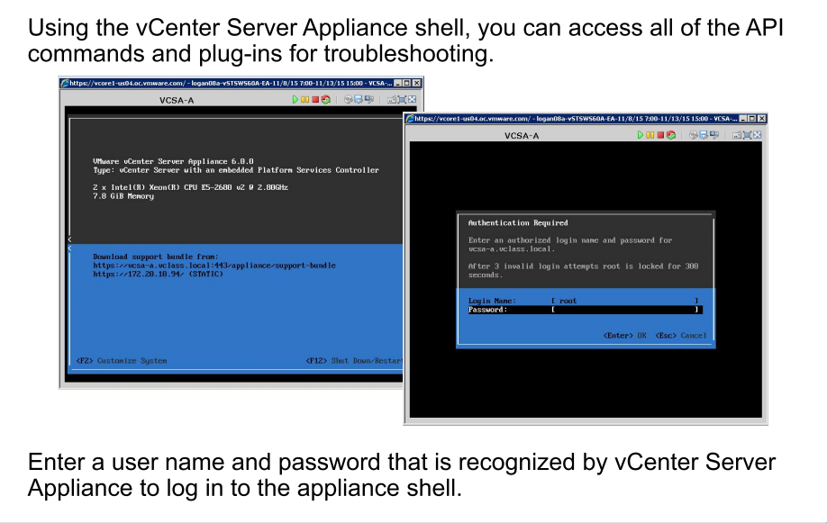
Accessing the vCenter Server Appliance Shell

Slide 23
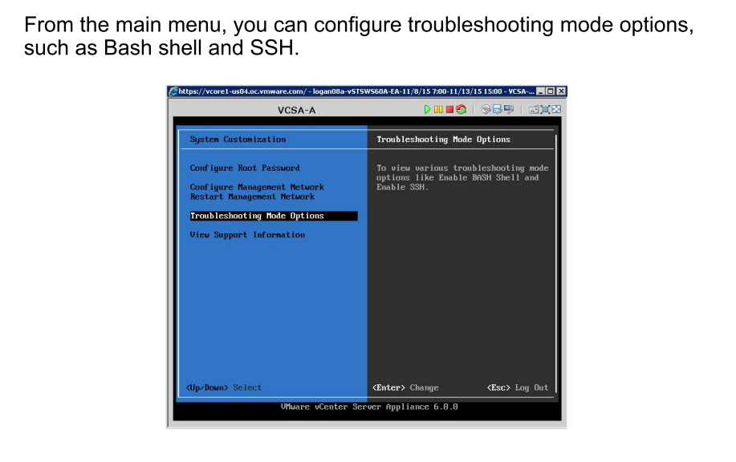
Accessing the vCenter Server Appliance Shell

Slide 24
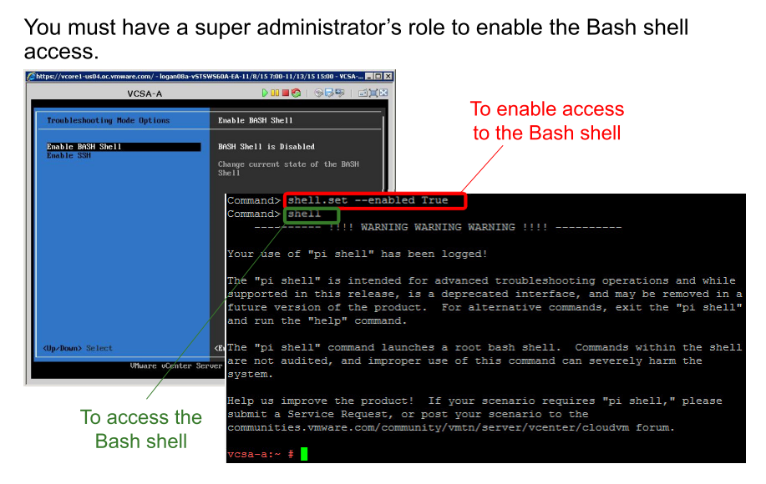
Enabling the Bash Shell from the Appliance Shell

Slide 25
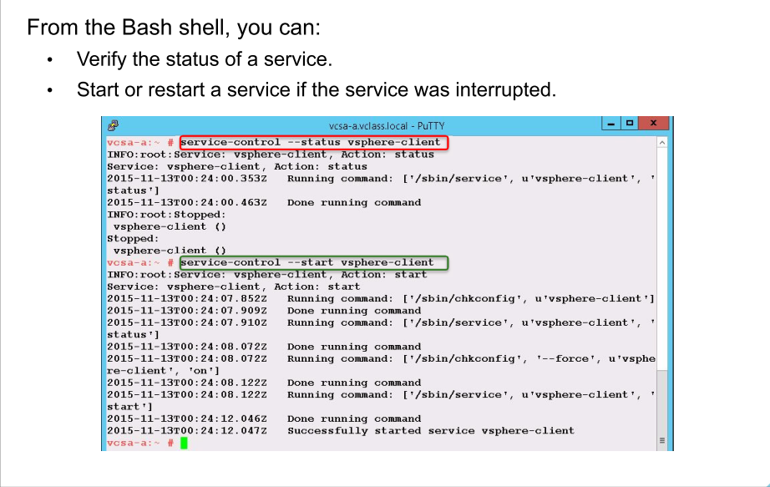
Querying Service Status and Restarting Services

Slide 26
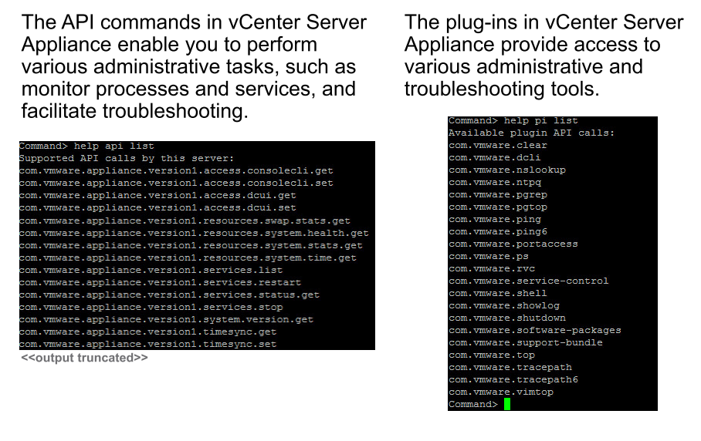
Using API Commands and Plug-Ins From the Appliance Shell

Slide 27
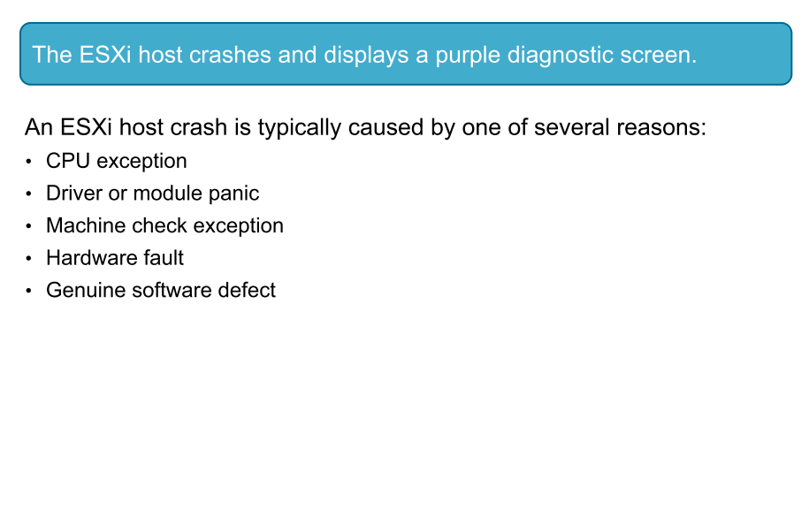
ESXi Problem 1

Slide 28
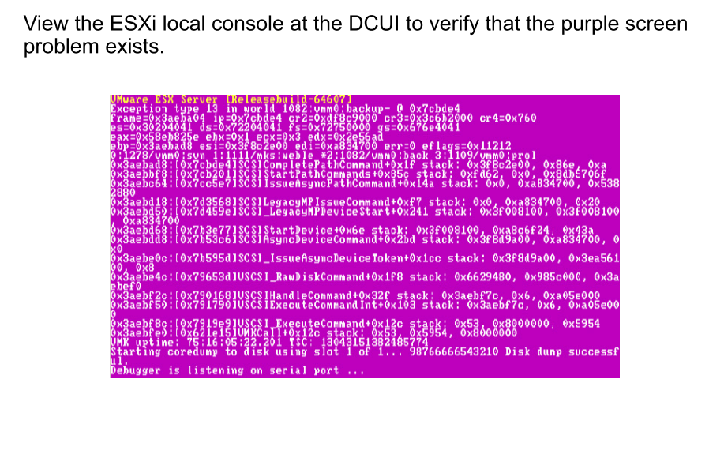
Verifying That the ESXi Host Crashed

Slide 29
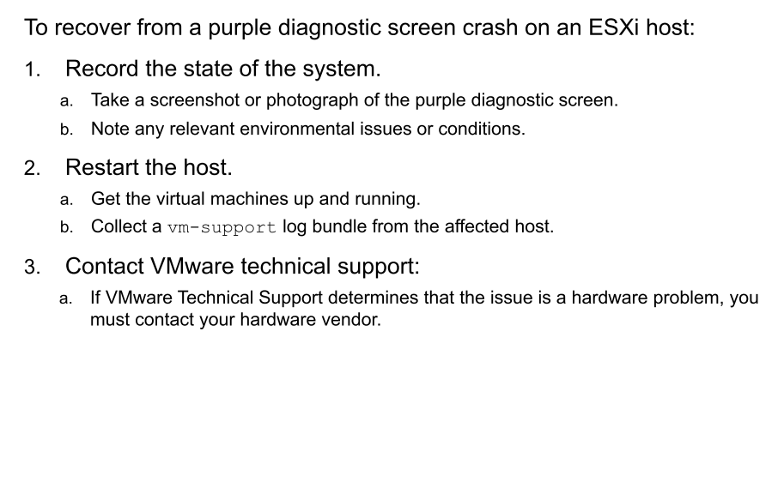
Recovering from a Purple Diagnostic Screen Crash

Slide 30
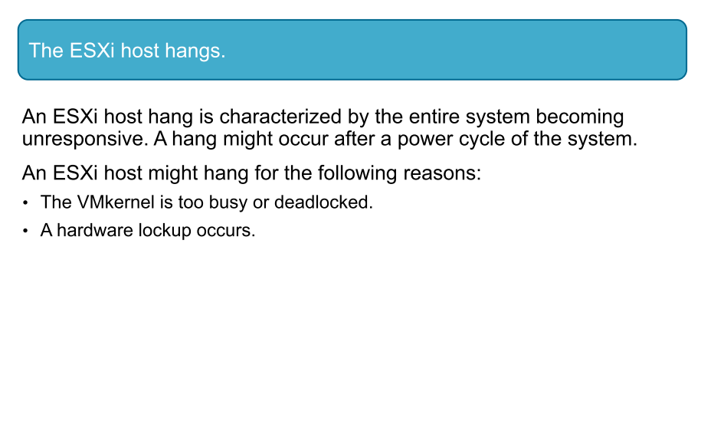
ESXi Problem 2

Slide 31
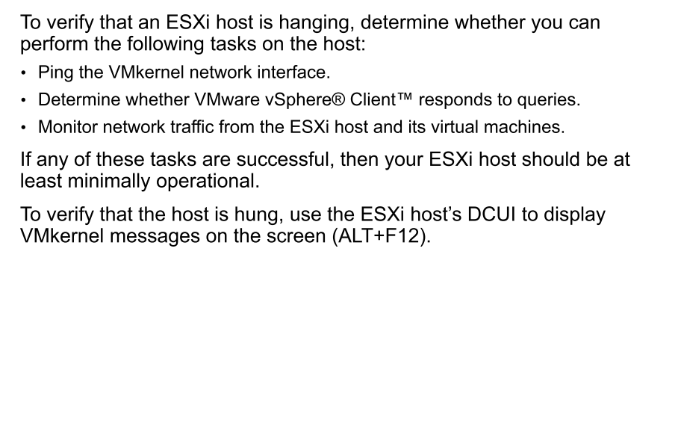
Verifying That the ESXi Host Is Hanging

Slide 32
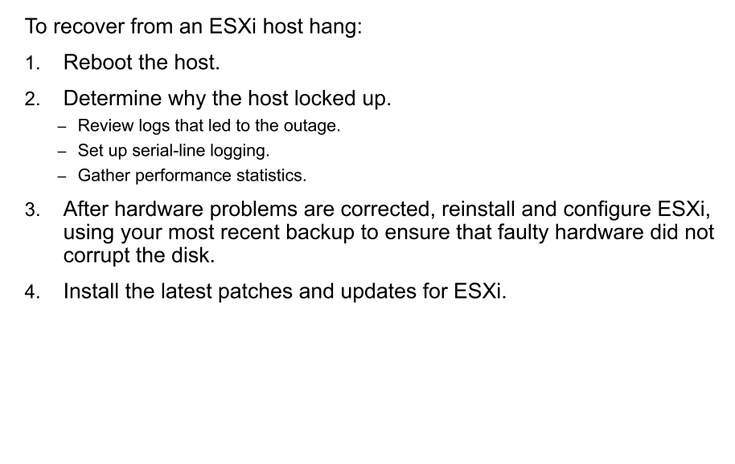
Recovering from an ESXi Host Hang

Slide 33
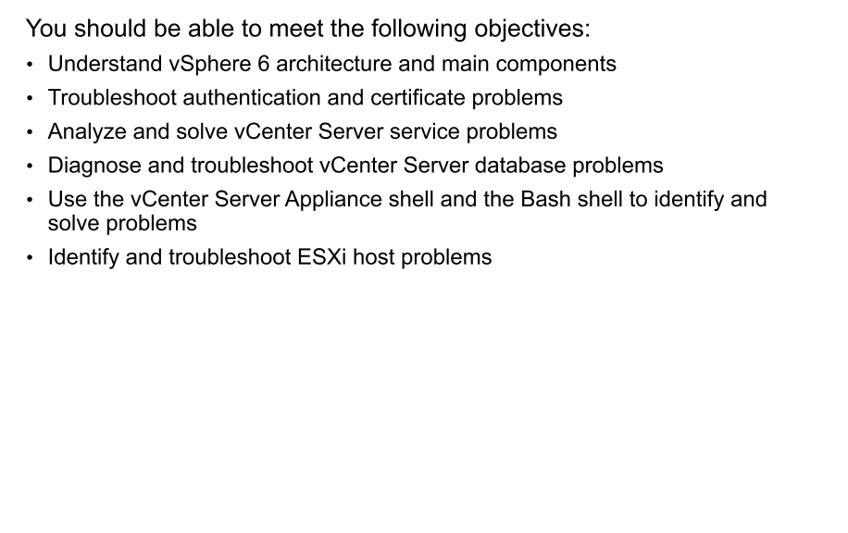
Review of Learner Objectives

